Slide 2


Alexandre Nunesse
anunesse@takima.fr
Benjamin Legros
blegros@takima.fr

Slide 3
Planning
Lundi
Mardi
Mercredi
Jeudi
Vendredi
AM
Cours
Cours
Cours
Exam
TD
TD
TD
PM
TP
Surprise

Slide 4
Evaluation
Compte rendu numérique:
documentation du projet
rapport de TP
ET
Examen écrit QCM

Slide 5
DevOps

Slide 6
Dev vs Ops
Development
(SOFTWARE
ENGINEERING)
Operations

Slide 7
Dev <3 Ops
Development
(SOFTWARE
ENGINEERING)
Operations

Slide 8
Dev ? Ops ? DevOps ?
Devs
Ops
Testers
Development
(SOFTWARE
ENGINEERING)
QA
(QUALITY
ASSURANCE)
Operations

Slide 9
Dev ? Ops ? DevOps ?
Software engineering culture
Unifying Dev & Ops
Title & role
Development
(SOFTWARE
ENGINEERING)
QA
(QUALITY
ASSURANCE)
DevOps
Operations
Notes:
10 deploys per day

Slide 10
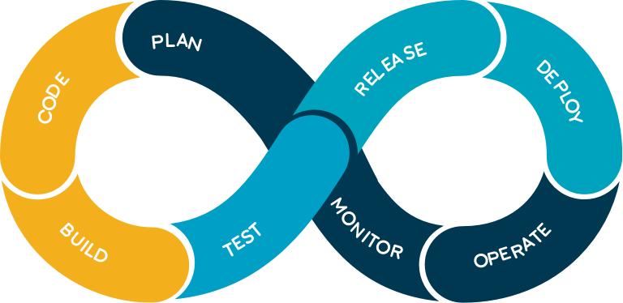
Dev ? Ops ? DevOps ?
3 main principles
Constant value stream
Feedback loop
Culture of experimentation and learning
Using:
Automation
CI/CD
Monitoring and logs
Everything as code
...

Slide 11
Devops - how ?

Slide 12

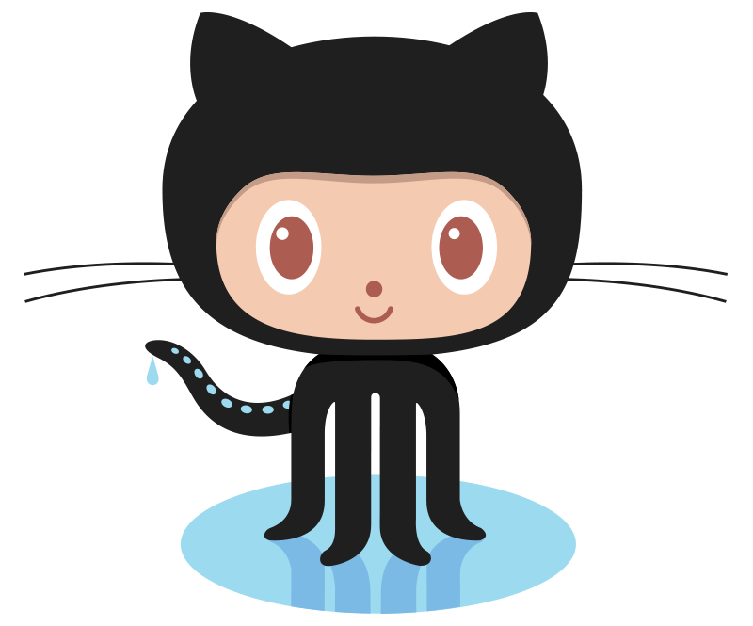


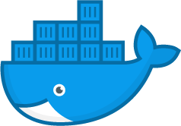
Devops : how ?
Your new friends :
Travis CI
Sonarcloud
Github
Docker
Ansible

Slide 13

Take away :
DevOps is a movement
To help collaborations between teams
To build resilient production apps
Based on :
craftsmanship
automation
sharing
Lots of tools to the rescue

Slide 14
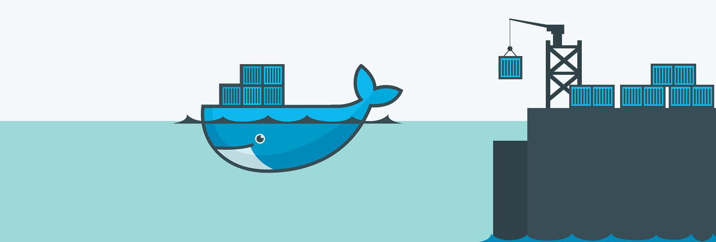
Docker
Put your application into containers

Slide 15
Once upon a time...
… in the land of infrastructures

Slide 16
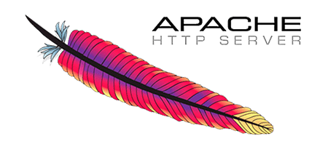
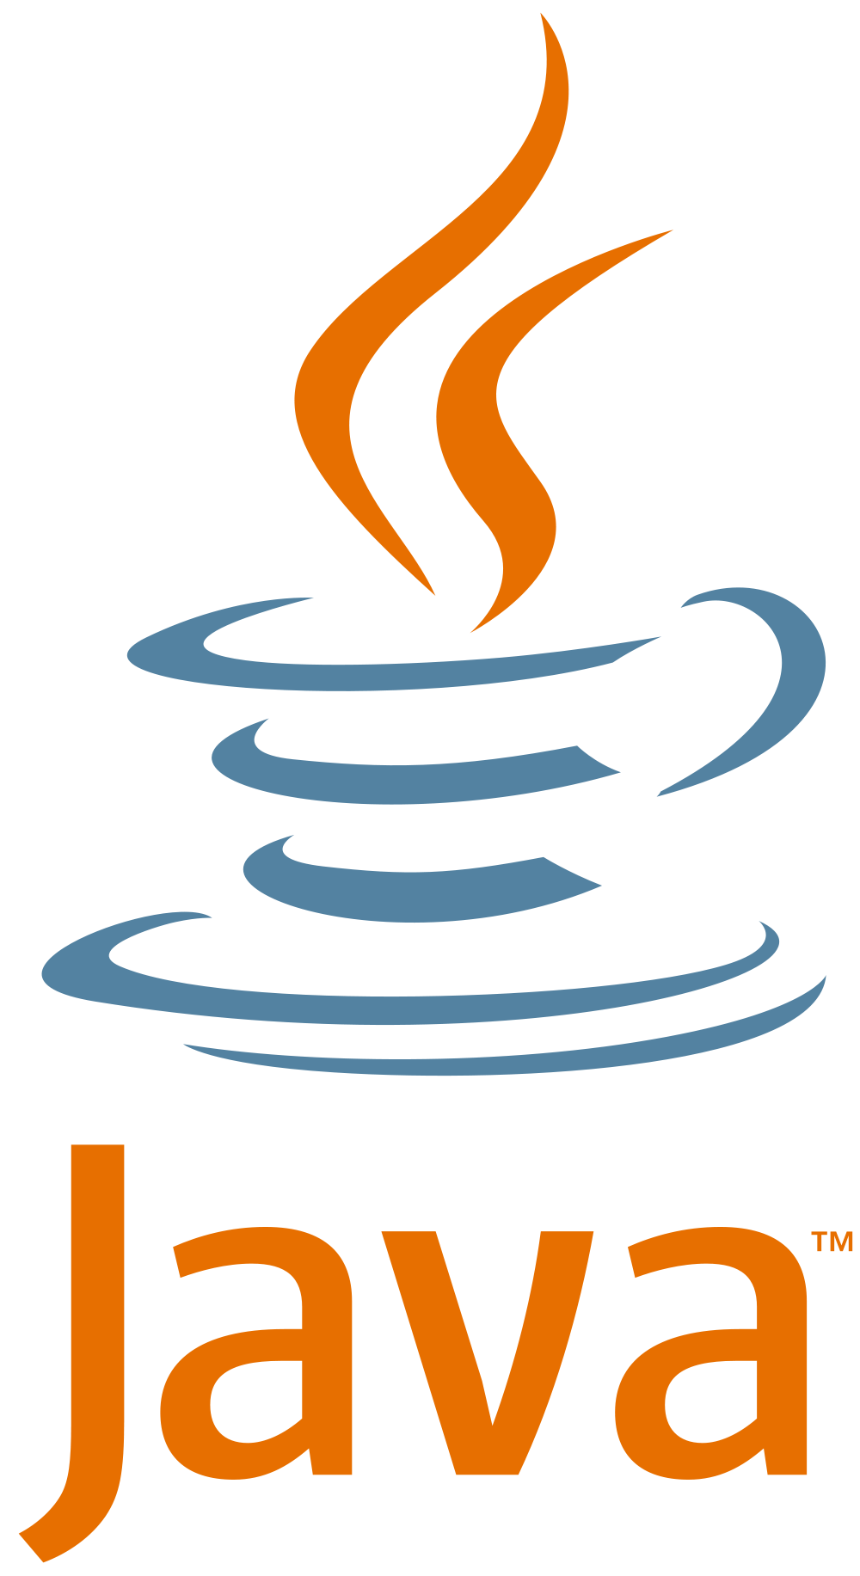

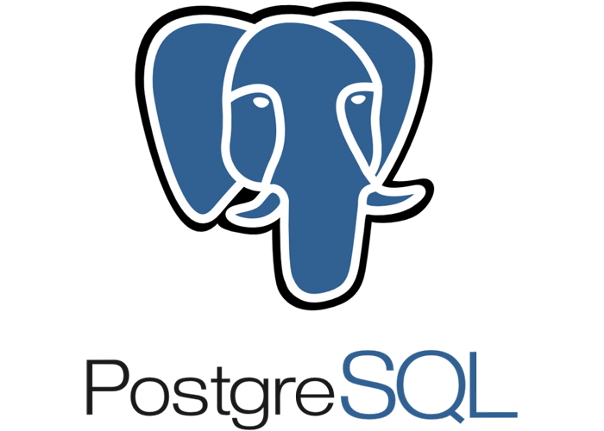
Use case
Simple 3-Tiers application
An HTTP server for your website
A Java application for your API
A PostgreSQL database for persistence

Slide 17

Once upon a time...
Your application is getting complex…
with multiple backend
with multiple languages
with a lot of config
http servers, SSL certs, firewalls, LDAP, …
… and harder to (re)deploy
no process isolation
bad for security & resiliency*
Company

Slide 18


Once upon a time...
Your application is getting complex…
Put things in bare-metal servers!
Company
PROS?
CONS?
?

Slide 19
Once upon a time...
Your application is getting complex…
Put things in bare-metal servers!
Great performance
Perfect process isolation
Costly
Harder to deploy and manage
Company

Slide 20
Once upon a time...
Your application is getting complex…
Put things in bare-metal servers!
Put things in VMs*.
Company
VM 1
VM 2
PROS?
?
VM 3
*VM: Virtual Machine

Slide 21
Once upon a time...
Your application is getting complex…
Put things in bare-metal servers!
Put things in VMs*.
Everything in a single package
Configure once, redeploy everywhere
No conflicting tools
ie: python2 + python3, JRE versions, …
Great process isolation
Company
VM 1
VM 2
VM 3

Slide 22
Containers
Why ?

Slide 23
Containers - Why ?
Your application is getting complex…
Put things in bare-metal servers!
Put things in VMs*.
Company
VM 1
VM 2
CONS?
?
VM 3

Slide 24
Containers - Why ?
Your application is getting complex…
Put things in bare-metal servers!
Put things in VMs*.
Company
VM 1
VM 2
Setup & maintenance
Performance overhead
requires beefy hardware
no resource management
Heavy to store and slow to start
Hard to share
GIT ? FTP ?
need other solutions (ig: Vagrant, Terraform, …)
VM 3

Slide 25
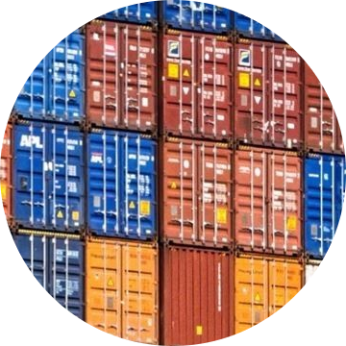
Docker
containers, containers everywhere !

Slide 26
Containers - docker
Open source
Docker != VM. Docker ≈ lightweight VM
Package application and its dependencies
Isolate processes
One usage = One docker
eg: front-end + back-end + 1 DB = 3 dockers
Build once, ship everywhere
One docker image for all environment
Version Control
Versioned images

Slide 27
Containers - docker
Clients
VM1
VM2
VM3
:80
:8080
:5432
bin & libs
bin & libs
bin & libs
Guest OS
Guest OS
Guest OS
Isolated processes:
Virtual Machines
slow virtual hardware
slow booting up guest OS
lock host’s resources
virtual HW
(RAM, CPU, NIC, HDD, …)
virtual HW
(RAM, CPU, NIC, HDD, …)
virtual HW
(RAM, CPU, NIC, HDD, …)
Host OS
Host Hardware
(RAM, CPU, NIC, …)

Slide 28
Containers - docker
Clients
docker1
docker2
docker3
:80
:8080
:5432
bin & libs
bin & libs
bin & libs
Isolated processes:
Virtual Machines
Containers
uses host hardware & software (fast)
do not boot guest OS (fast)
minimal virtualization overhead
Docker engine
Host OS
Host Hardware
(RAM, CPU, NIC, …)

Slide 29
Containers - docker
Docker rather than VMs ?
runs processes right on host OS
no virtualization overhead
fast
start, stop, recreate containers in seconds
emulated process isolation
Dockerfile
Repeatable builds
can be versioned
1 single artifact, deployed everywhere
(binaries, libraries, conf, files …)

Slide 30
Docker stuff
From images to running containers

Slide 31
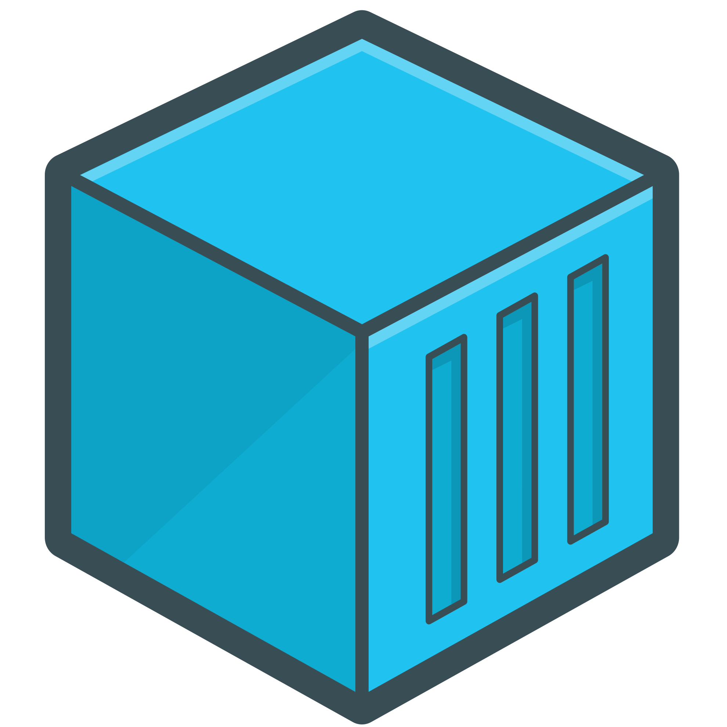
Docker - containers
Docker is about containers.
Containers:
are small
one container = one purpose
minimal size
# run the latest nginx version in a container with name nginx
docker container run --name my-nginx nginx:latest

Slide 32
Docker - containers commands
# Run a nginx container with name my-nginx
docker container run nginx -it --name my-nginx
# Run a nginx container of version 1.15.8 with name my-nginx
docker container run nginx:1.15.8 --name my-nginx -it
# Run a container in detached mode (not linked to a terminal)
docker container run nginx:1.15.8 --name my-nginx -it -d
# Stop a running container
docker container stop my-nginx
# Kill a running container (sends a SIGKILL)
docker container kill my-nginx
# Lists all running containers (-a to add those that died)
docker container ps

Slide 33
Docker - networks
Containers:
communicate together
one application = dozen of containers in a network
# create a network
docker network create public-net
# run nginx
docker run -d --name my-nginx --network=public-net nginx
# run java
docker run -d --name my-java --network=public-net java

Slide 34
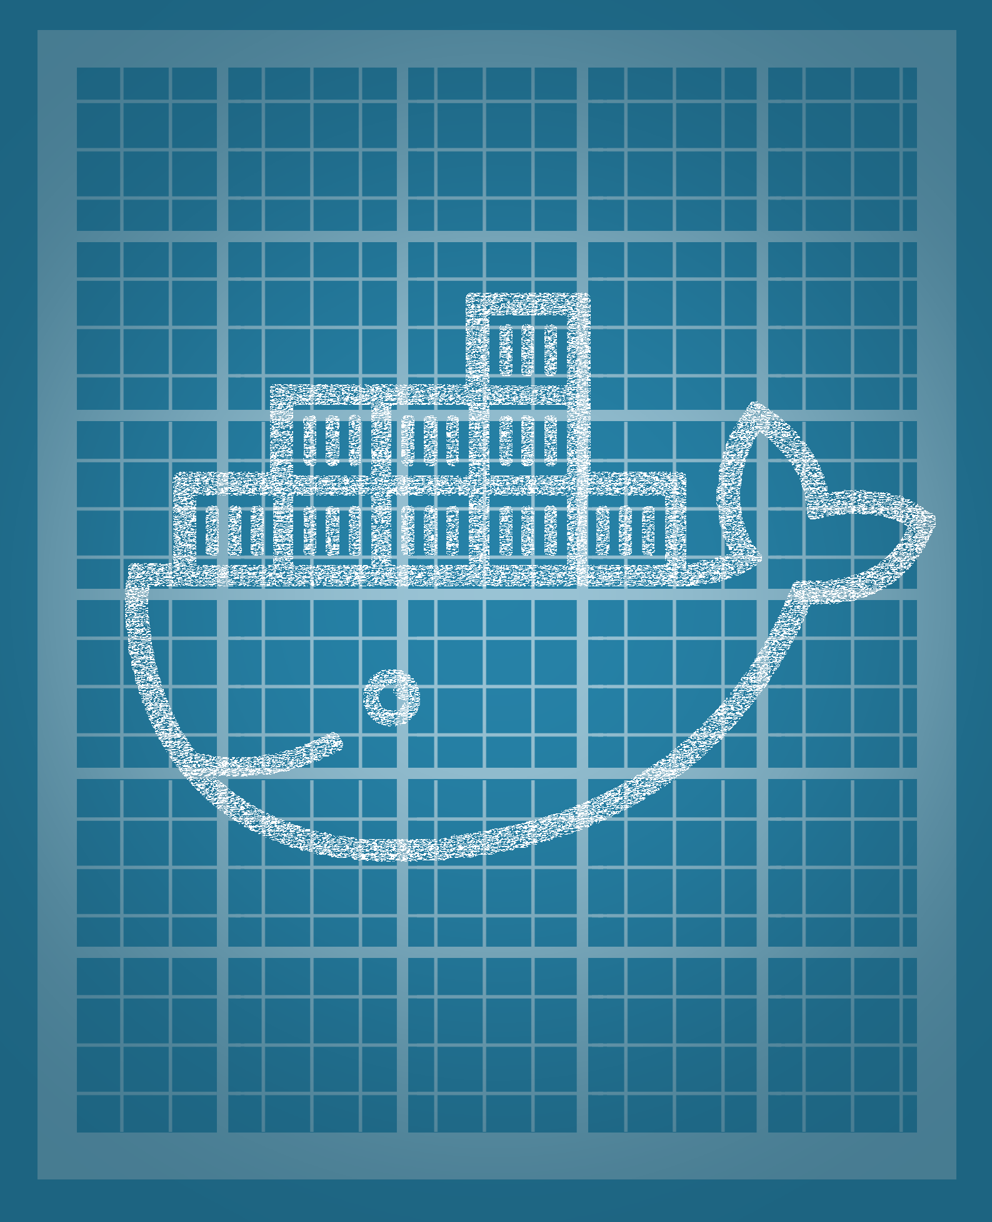
Docker - images
Dockerfile :
put layers on top of other images
# Base image
FROM ubuntu:18.10
# Run a command in the container
# (eg: install a dependency)
RUN apt-get install sl
# Default program to run when container starts
ENTRYPOINT [“sl”]
# Default command/args to pass to command above
CMD [“.”, “-Fe”]
layer 1
layer 2
layer 3

Slide 35
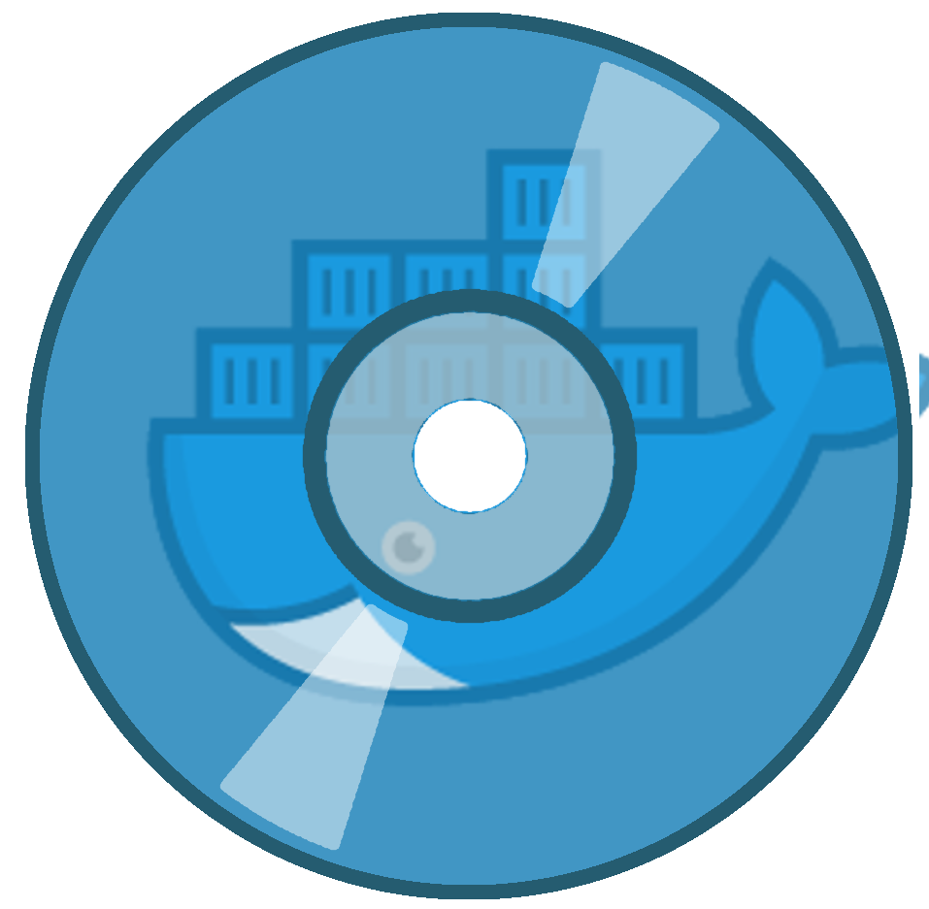
Docker - images
Images
built with Dockerfile
“makefile” for docker images
# build docker image
docker build . -t my-app
java:latest
conf
jar
...
>$ docker build
>$ docker run
Dockerfile
docker image
docker container

Slide 36
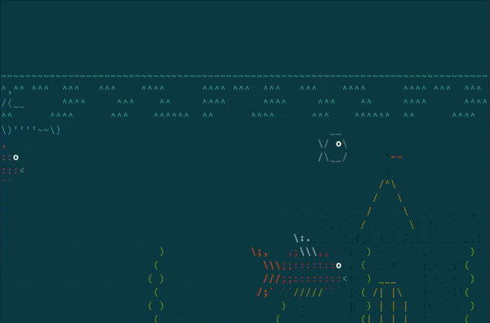
Docker - images
Demo - Livecoding
asciiquarium with docker

Slide 37
Take away
Start with an appropriate base image
Use official images
Reduce the number of layers
One container = one concern
No unnecessary packages installation (Text Editor …)
Never use latest as a version
https://docs.docker.com/develop/dev-best-practices/#how-to-keep-your-images-small
https://docs.docker.com/engine/userguide/eng-image/dockerfile_best-practices

Slide 38
Docker universe
Docker-compose, Docker HUB & co

Slide 39
Docker universe: Docker compose
Manage multiple containers together
build, run, start, stop, repeat
Declarative YAML Syntax
Services (= containers)
Networks
Volumes
# docker-compose.yml
version: ‘3’
services:
myapp-web:
image: “httpd”
ports:
- “80:80”
myapp-api:
image: “java-jre”
myapp-db:
image: “postgres”

Slide 40
Docker universe: Docker HUB
docker images central repository
public place to store docker images
host docker images
images are already built
official & unofficial images
hub.docker.com

Slide 41
References
Why docker
https://docs.docker.com/
https://roadmap.sh/devops

